Slide 1

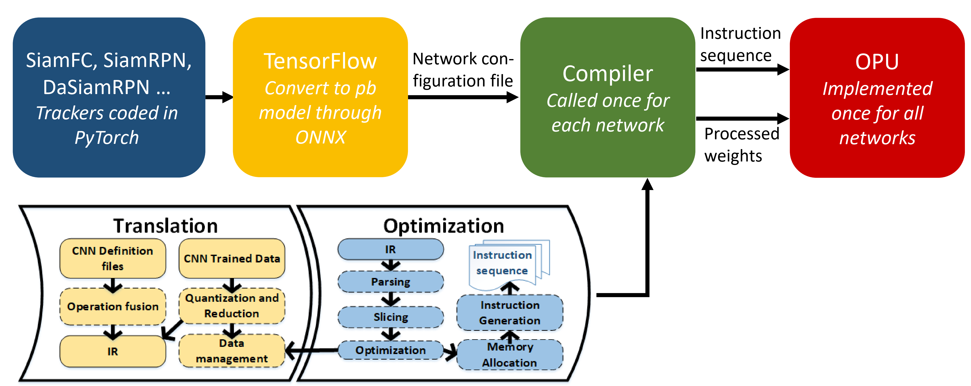
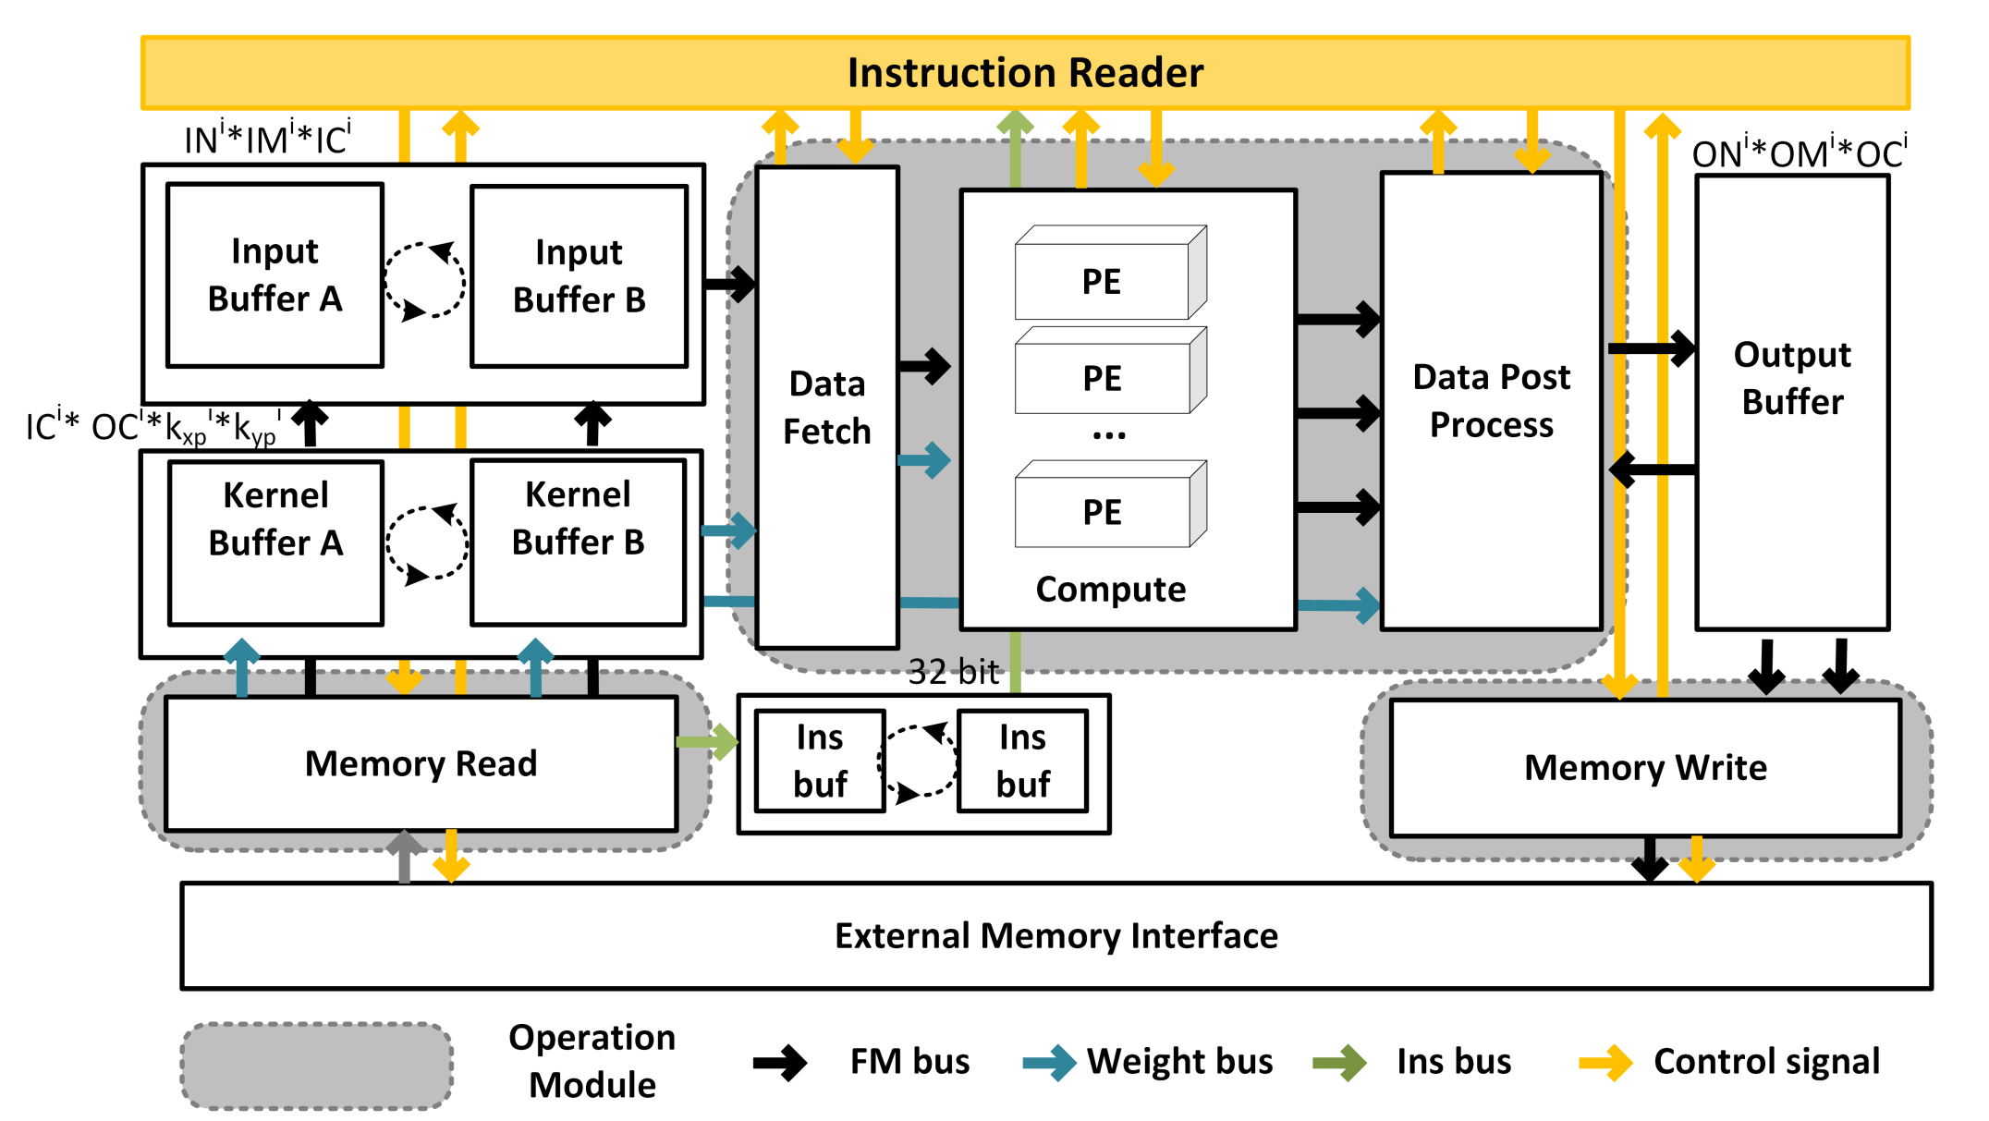
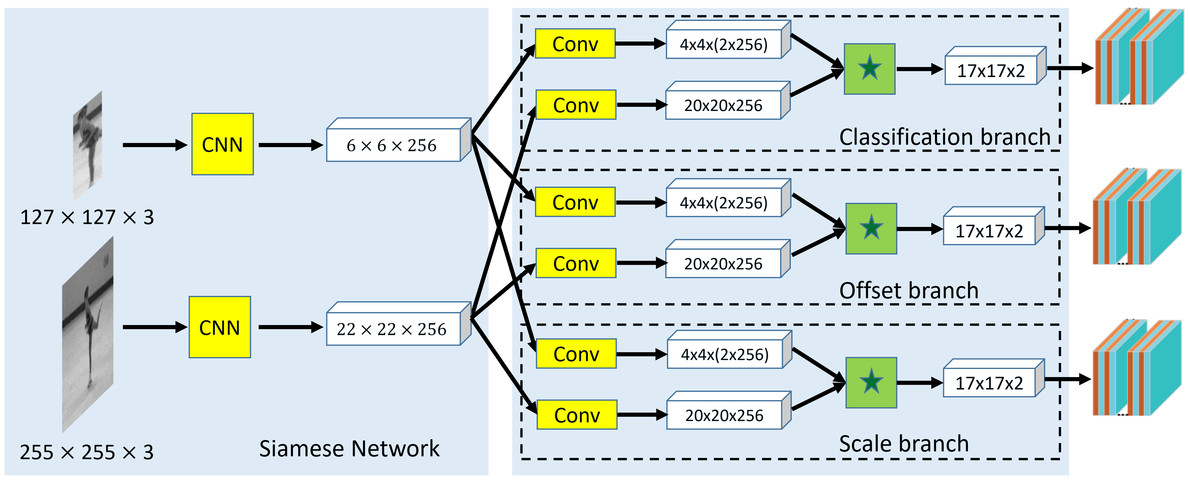
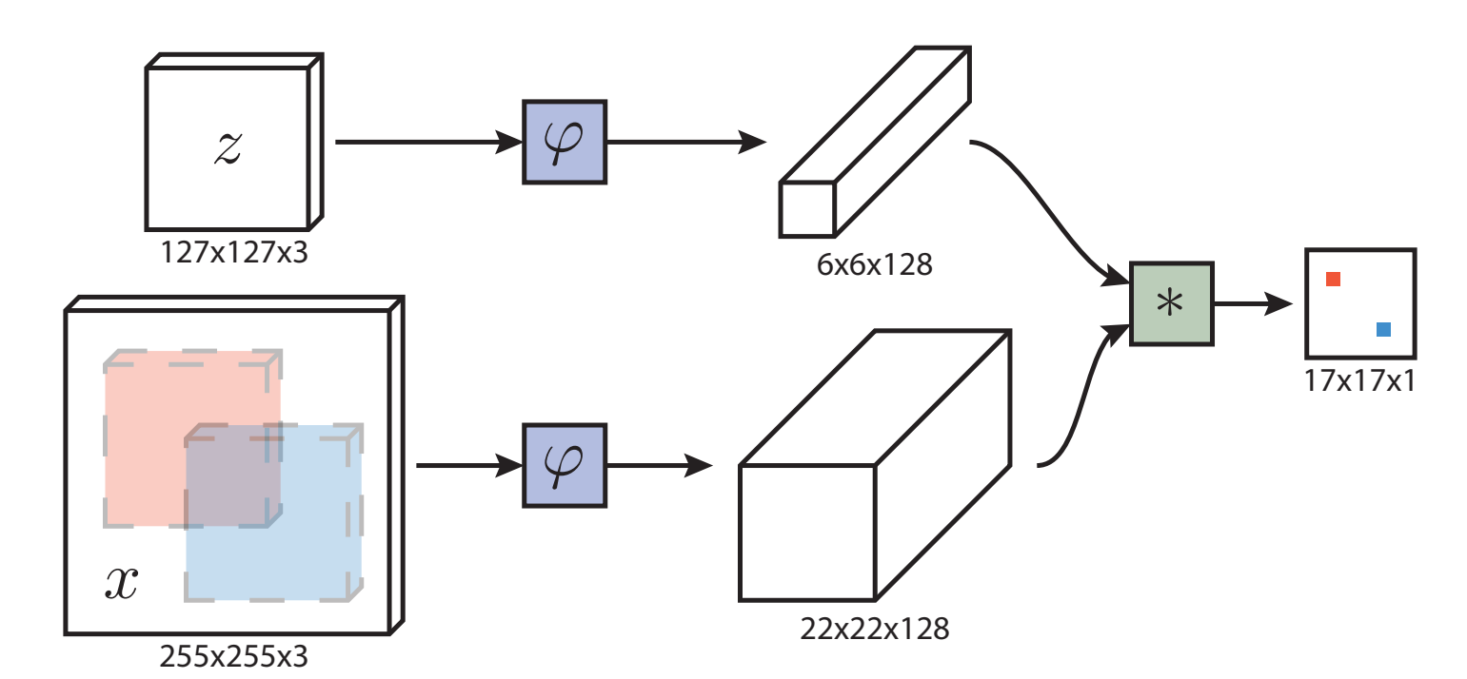
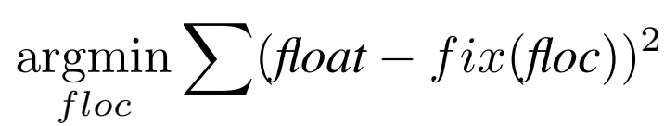
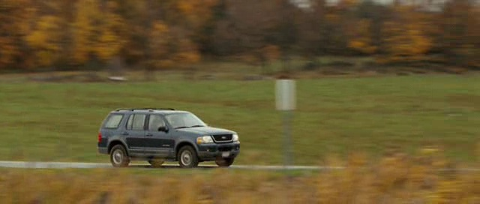
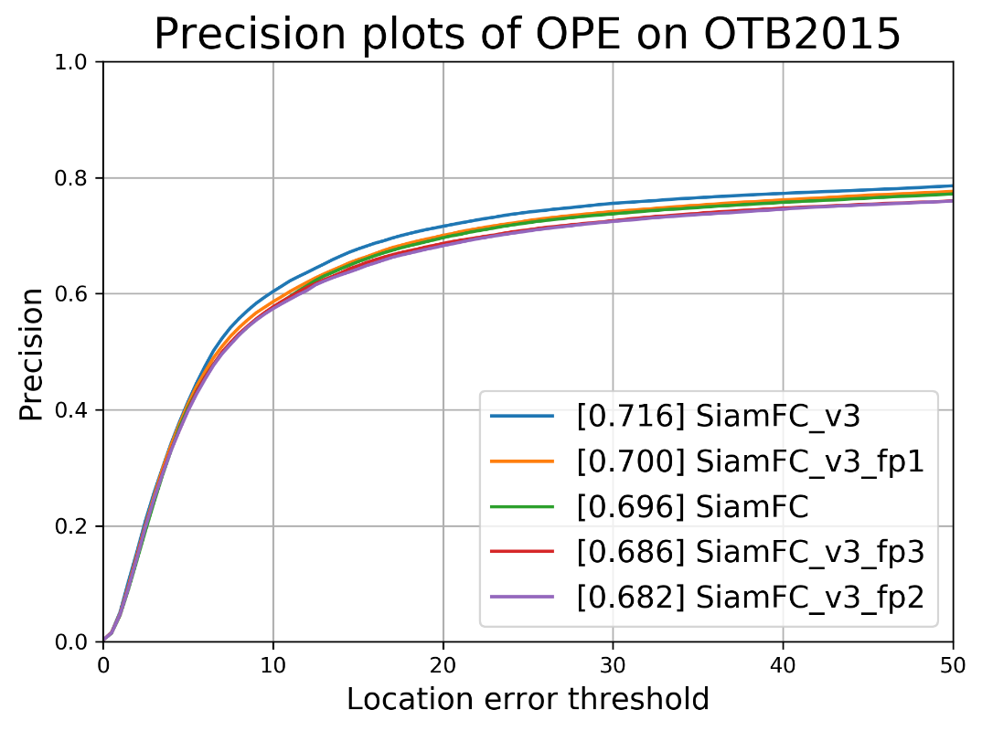
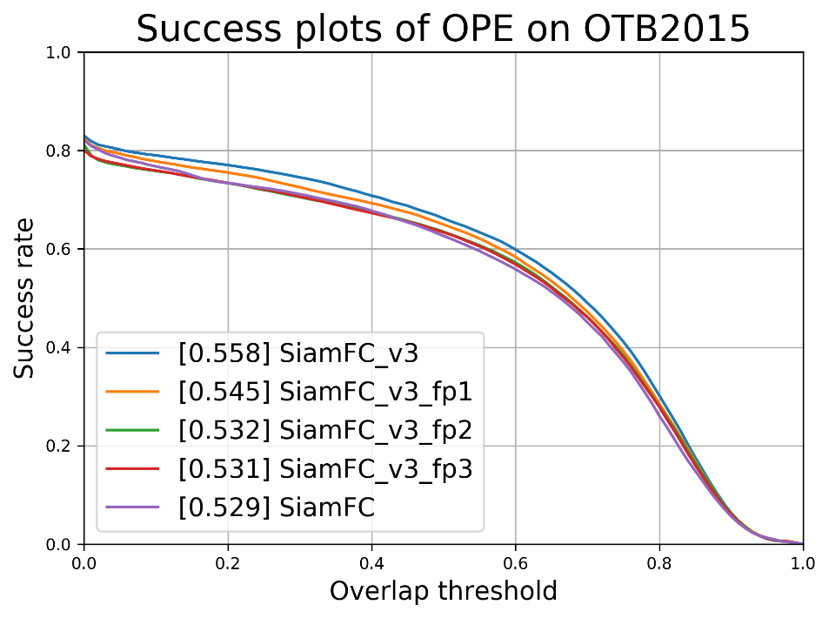
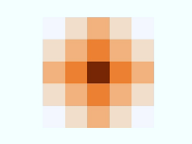
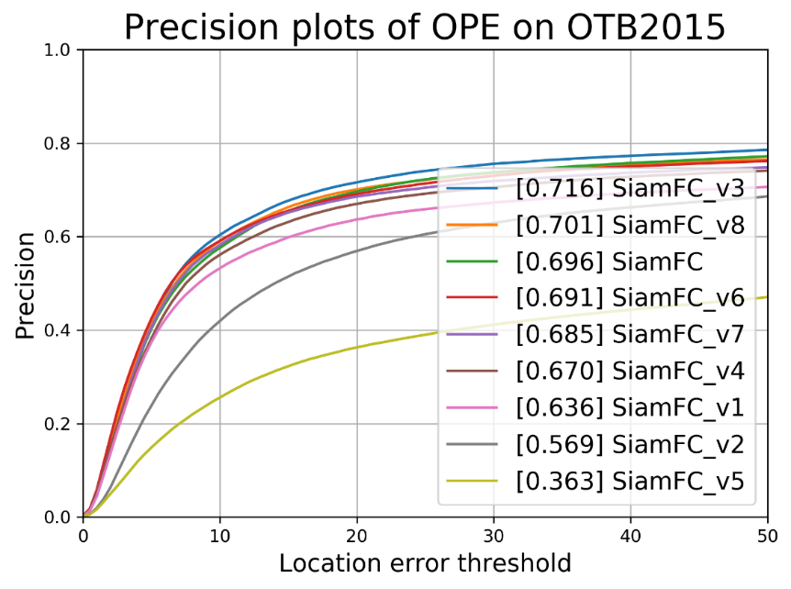
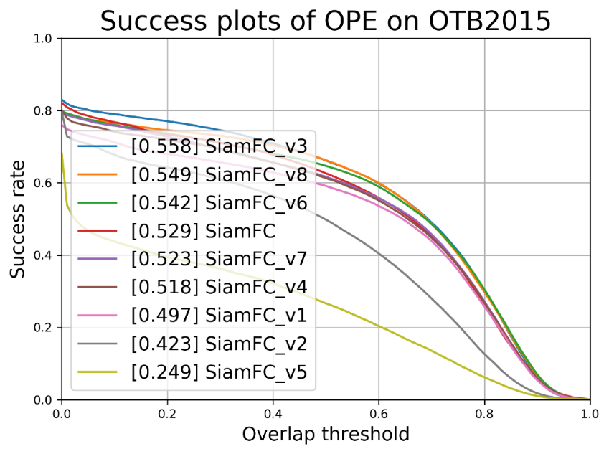
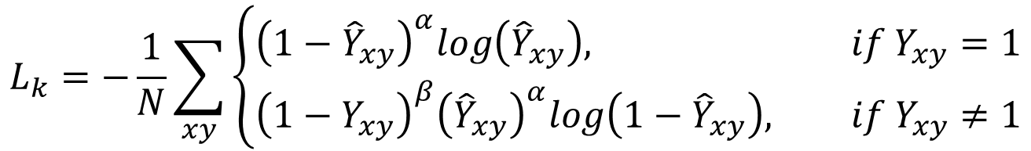
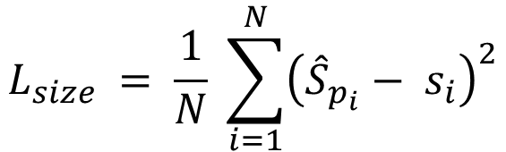
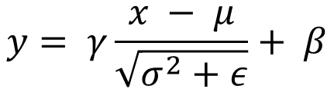
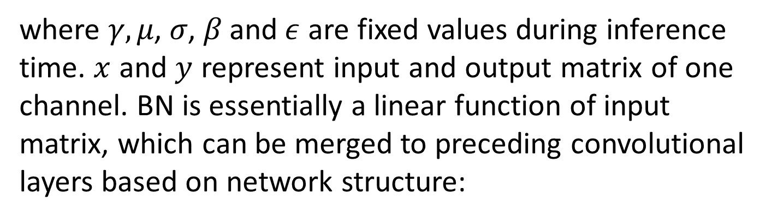
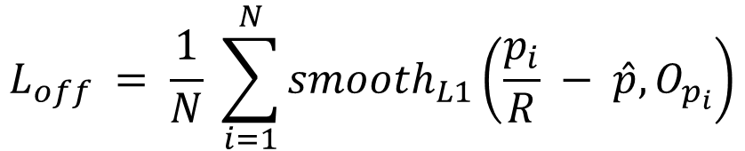
Email:
pengshengyun@sina.com
FPGA-based Processor for Video Object Tracking
Shengyun Peng
Introduction and Motivation
Overlay Processor for Convolutional Neural Networks
FPGA-based acceleration for CNN, including object tracking
Huge computation requirement of CNN leads to hardware acceleration
FPGA has advantage of low NRE, quick time to market and low latency
FPGA is more power efficient compared with GPU
Designing an FPGA accelerator for a specific CNN can be time consuming even for experienced FPGA developer
FPGA, which operates much faster than GPU edge device Jetson TX1 and TX2, is more suitable for real time tracking
Propose a RTL based hand-coded FPGA overlay domain-specific processor unit (OPU) with software programmability and fast compilation time, targeting at general CNN accelerations
Object tracking algorithms
Aims to estimate the position of an arbitrary target in a video sequence, given only its location in the initial frame
Siamese networks have drawn great attention because of their balanced accuracy and speed
Multi-scale test and anchor generation enumerate a nearly exhaustive list of potential object locations and classify each of them, which is inefficient
Our novel tracker represents an object by a single point at bounding box center, and other properties such as object size and local offsets are regressed directly from image features at the center location
OPU working pipeline
Tracking network is realized in PyTorch. Then, trackers are converted into TensorFlow version for further network fusion and data quantization. Models are compiled into instructions. This is done only once for each net-work. Then instructions are executed by OPU which is implemented on FPGA and is fixed for all networks. The CNN algorithm developer does not need to deal with FPGA implementation.
Siamese Anchor Free
Tracking Algorithm Improvement
Network Fusion and Quantization
SiamAF Network structure
SiamFC
Fusing BN and convolution in runtime
A batch normalization operation can be represented by:
$$y= γ\frac{x − μ}{\sqrt{σ^{2}+ε}}+ β$$
where $γ, μ$, $σ$, $β$and$ε$ are fixed values during inference time. $x$ and $y$ represent input and output matrix of one channel. BN is essentially a linear function of input matrix, which can be merged to preceding convolutional layers based on network structure:
Training loss
The output is a score map whose dimension depends on the size of the search image. This enables the similarity function to be computed for all translated sub-windows within the search image in one evaluation. The red and blue pixels in the score map contain the similarities for the corresponding sub-windows.
$${\hat{f}}_{i,j}=W_{BN}∙\left(W_{conv}∙f_{i,j}+b_{conv}\right)+b_{BN}$$
Classification focal loss
Data quantization
$$L_{k}=−\frac{1}{N}\sum_{xy}{\left\{\begin{aligned}{\left(1−{\hat{Y}}_{xy}\right)}^{α}log\left({\hat{Y}}_{xy}\right), if Y_{xy}=1 \\ &{\left(1−Y_{xy}\right)}^{β}{\left({\hat{Y}}_{xy}\right)}^{α}log\left(1−{\hat{Y}}_{xy}\right), if{ Y}_{xy}≠1\end{aligned}\right.}$$
Taking general network precision redundancy and hardware architecture complexity into consideration, 8 bit is chosen as our data quantization standard for both feature map and kernel weights. Dynamic quantization scheme has been employed for better accuracy. In such scheme, each layer’s kernel weights and feature maps have their own range for higher precision. The process of finding the best range is described as follows:
where $Y_{xy}=\frac{1}{2πσ_{1}σ_{2}} exp\left\{−\frac{1}{2}\left[\frac{{\left(x− μ_{1}\right)}^{2}}{σ_{1}^{2}}+\frac{{\left(y− μ_{2}\right)}^{2}}{σ_{2}^{2}}\right]\right\}$
Conclusions and guidelines
Local offset loss
$$L_{off} = \frac{1}{N} \sum_{i=1}^{N}{{smooth}_{L1}\left(\frac{p_{i}}{R} − \hat{p}, O_{p_{i}}\right)}$$
Siamese trackers prefer a relatively small network stride.
The receptive field of output features should be set based on its ratio to the size of the exemplar image (60% ~ 80% for an exemplar image)
Receptive field determines the image region used in computing a feature. A large receptive field covers much image context
Group convolution increases the robustness of network, which also improves the tracking speed
More channel numbers extract more features and offer more similarity information for comparison
Scale loss
$$L_{size} = \frac{1}{N} \sum_{i=1}^{N}{{\left({\hat{S}}_{p_{i}}− s_{i}\right)}^{2}}$$
The result of quantization is shown as follows:
Keypoint heatmap [2]
Local offset [2]
Object size [2]
$$bbox=\left({\hat{x}}_{i}+δ{\hat{x}}_{i}−\frac{{\hat{w}}_{i}}{2},{\hat{y}}_{i}+δ{\hat{y}}_{i}−\frac{{\hat{h}}_{i}}{2},{\hat{x}}_{i}+δ{\hat{x}}_{i}+\frac{{\hat{w}}_{i}}{2},{\hat{y}}_{i}+δ{\hat{y}}_{i}+\frac{{\hat{h}}_{i}}{2}\right)$$
Acknowledgements
This work was supported by Cross-disciplinary Scholars in Science and Technology (CSST) grants from UCLA. Shengyun Peng gratefully acknowledges the helpful discussions with Prof. He and Yunxuan Yu. Special thanks to all the group members throughout this project including Tiandong Zhao, Weinan Song, Yanyue Xie, Xinyuan Chu, Yifeng Xiao and Zihang Jiang.
References
[1] B. Li, J. Yan, W. Wu, Z. Zhu, and X. Hu. High performance visual tracking with Siamese region proposal network. In Proceedings of the IEEE Conference on CVPR, pages 8971-8980, 2018.
[2] L. Bertinetto, J. Valmadre, J. F. Henriques, A. Vedaldi, and P. H. S. Torr. Fully-convolutional siamese networks for object tracking. In ECCV, pages 850–865, 2016.
Groundtruth
SiamAF
SiamFC

